Slide 1
Values-based food supply chains
Value Chains

Slide 2
Mainstream food supply chains have these characteristics:
Each company in the chain seeks to buy as cheaply and sell as expensively as possible.
  This leads to:
    business relationships that are competitive and adversarial (win-lose)
    a lack of trust among marketing channel members

Slide 3
Mainstream food supply chains have these characteristics:
Farmers:
  are often operating in restricted markets or under short-term contracts
  bear much of the risk
  may be treated as interchangeable (and exploitable) input suppliers

Slide 4

Mainstream food supply chains have these characteristics:
Benefits and profits from the sale of food products to the final consumer are not evenly distributed across the supply chain.
  Food processors and marketers usually receive a disproportionately higher share.

Slide 5
Values-based food supply chains are different from mainstream food supply chains in two ways:
1. Business relationships among strategic partners interacting in the supply chain are based on a written set of values (values-based supply chains).
  Business relationships are framed in win-win terms where all supply chain partners have a strategic interest in the performance and well-being of other partners, resulting in high level of interdependence and trust.

Slide 6
Values-based food supply chains are different from mainstream food supply chains in two ways:
  Farmers are strategic partners with rights and responsibilities related to supply chain information, risk-taking, governance and decision making.
  The welfare of all strategic partners is taken into consideration including appropriate profit margins, living wages and long-term business agreements.

Slide 7
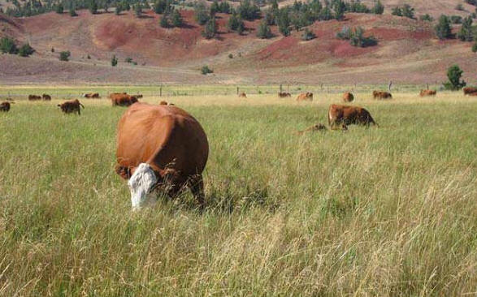

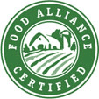
Values-based food supply chains are different from mainstream food supply chains in two ways:
2. Products are differentiated from similar food products based on product attributes such as food quality, safety, and/or functionality along with environmental and social attributes such as sustainable or organic production and treatment of farm workers or animals.
Healthy Animals

Slide 8
We will refer to values-based food supply chains as “value chains.”

Slide 9
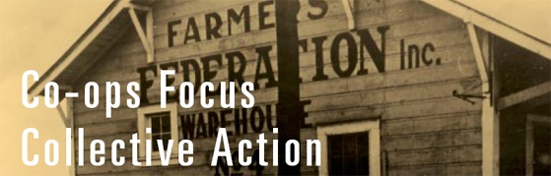
General characteristics of value chains
Value chains combine scale with product differentiation, and cooperation with competition, to achieve advantages in the marketplace.
  Cooperation within the supply chain, competition with other supply chains

Slide 10
General characteristics of value chains
Value chains emphasize high levels of inter-organizational trust.
  Inter-organizational trust is pivotal to successful value chains.
    Inter-organizational trust will still be in place even if key people leave because it is based on organizational procedures—it is process-based trust.
    Inter-organizational trust is built on fairness, stability, predictability of agreements among strategic partners and confidence that partners will not exploit the other’s vulnerabilities.

Slide 11
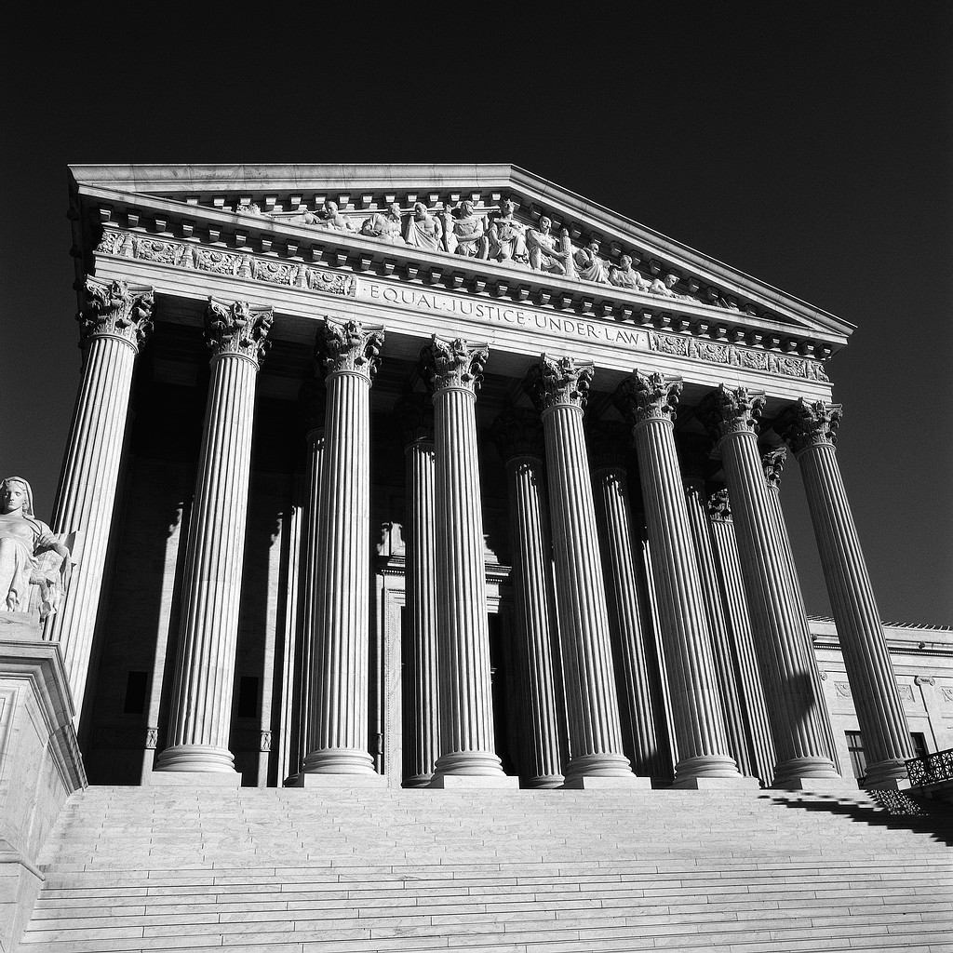
General characteristics of value chains
Value chains emphasize shared values and vision, shared information (transparency) and shared decision making among the strategic partners.
  Shared information improves productivity and enables rapid responses to market changes.
  Shared decision making can be framed in familiar shared governance terms:
    Legislative—sets standards for the chain
    Judicial—monitors performance in the chain
    Executive—coordinates procedures and flows in the chain

Slide 12
General characteristics of value chains
  Shared decision making means all partners experience a sense of fairness and justice.
    Distributive justice—rewards/profits are distributed fairly among all strategic partners
    Procedural justice—all partners experience rules of business as fair

Slide 13
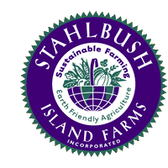
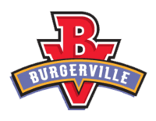

General characteristics of value chains
Value chains emphasize high levels of performance.
  High levels of performance are essential to deliver high- quality products and services.
    Appropriate standards need to be developed and performance evaluations conducted across the entire chain.
    Quality assurance and continuous improvement systems need to be employed.
http://www.youtube.com/watch?v=UfEJBTuGjC8

Slide 14
Mid-tier value chains are strategic alliances between mid-size, independent (often cooperative) food production, processing, distribution and sales enterprises that seek to create and retain more value on the farmer end of the supply chain, and effectively operate at regional levels with significant volumes.

Slide 15
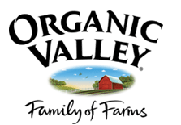
What we know about mid-tier value chains
They are appropriate for situations in which regionally oriented markets are developing for significant volumes of differentiated, value-adding food products.
Horizontal collaborations are often required to assemble sufficient volumes of differentiated food products.

Slide 16
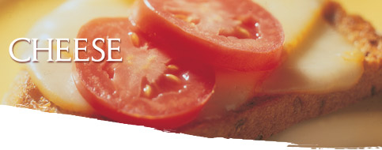
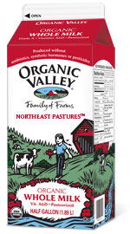



What we know about mid-tier value chains
Appropriate standards and efficient methods of third-party certification of the standards need to be applied throughout the supply chain.
Farmers are able to maintain ownership and control of brand identities on food products throughout the chain.

Slide 17
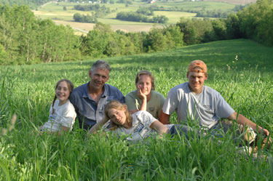
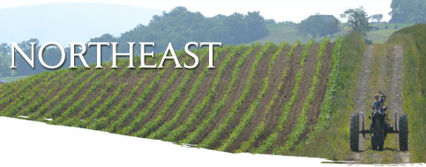
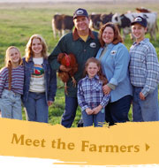
What we know about mid-tier value chains
It takes time for all strategic partners to become comfortable with this alternative business model based on trust and organizational interdependence because of the history of adversarial relationships in mainstream U.S. food supply chains.

Slide 18
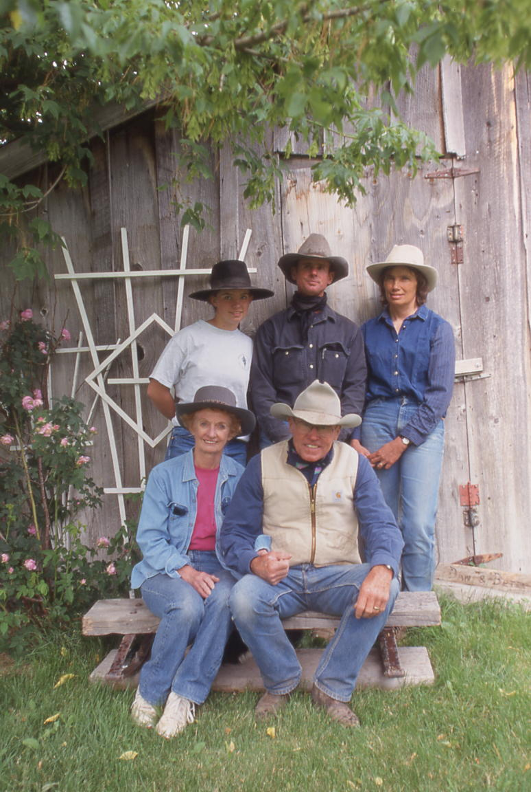
Challenges for mid-tier value chains
Finding appropriate values-based chain partners and developing mechanisms for trust, transparency and decision-making
Determining effective strategies for product differentiation, branding and regional identity
Developing food quality control systems
that address weather, seasonality,
multiple production sites and
quality-preserving distribution mechanisms

Slide 19
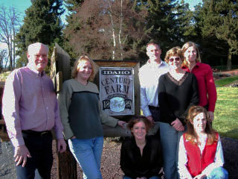
Challenges for mid-tier value chains
Determining appropriate strategies for product pricing based on understanding the true costs of production
Building sufficient trust among competing producer groups to form farmer networks large enough to supply sufficient and consistent volumes of high-quality, differentiated food products

Slide 20
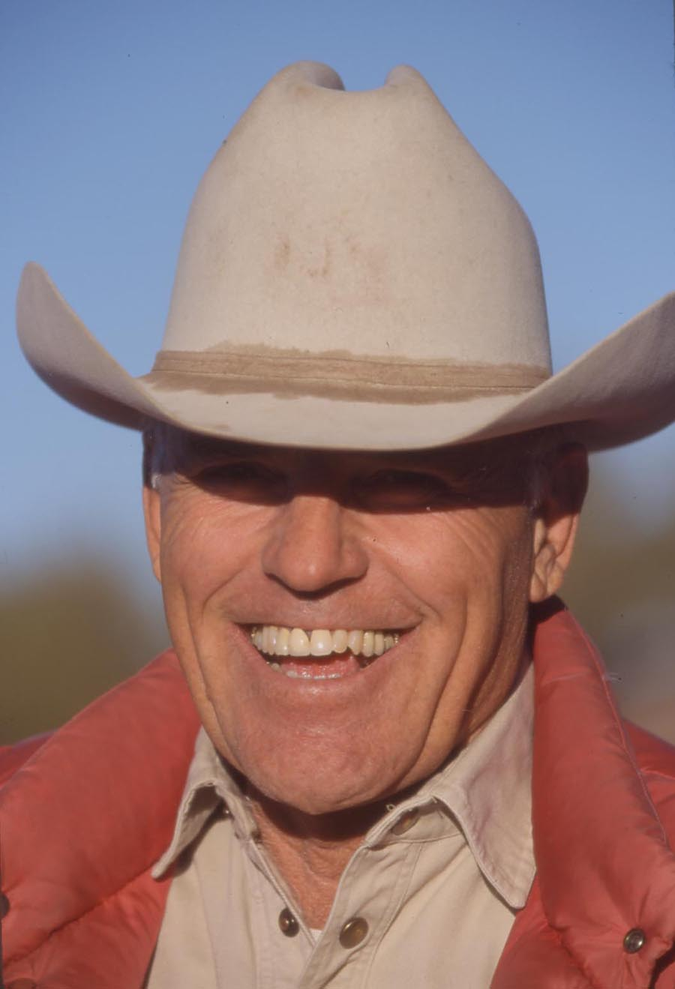
Challenges for mid-tier value chains
Acquiring adequate capitalization and competent management
Accessing adequate technical, research and development support
Creating meaningful standards and consistent certification mechanisms
across the chain

Slide 21
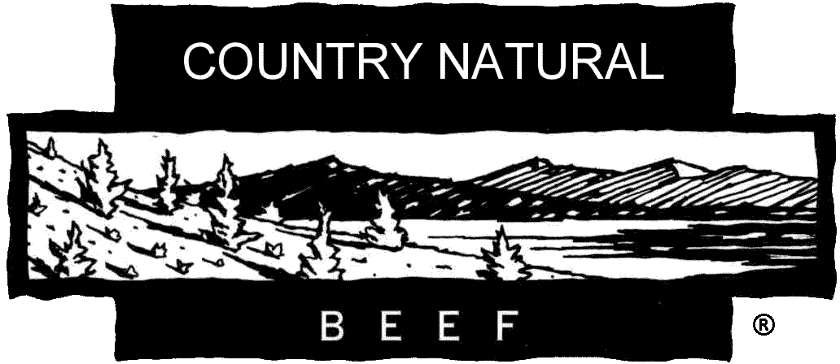
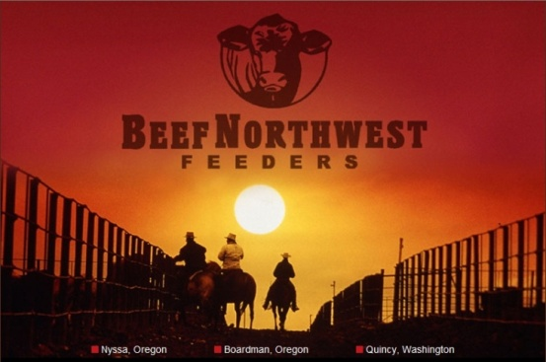
Example of a mid-tier value chain
Country Natural Beef
A cooperative of family-owned ranches mostly in Oregon (but also in 15 other states) that raise cattle from birth without growth hormones or feeds containing antibiotics, genetically modified grains or animal by-products.
Cattle spend about 90 days (rather than 120-150) in a CNB-owned feedlot on “cooler” (30% grain vs. 80%) rations (potatoes, alfalfa, barley, some corn).

Slide 22
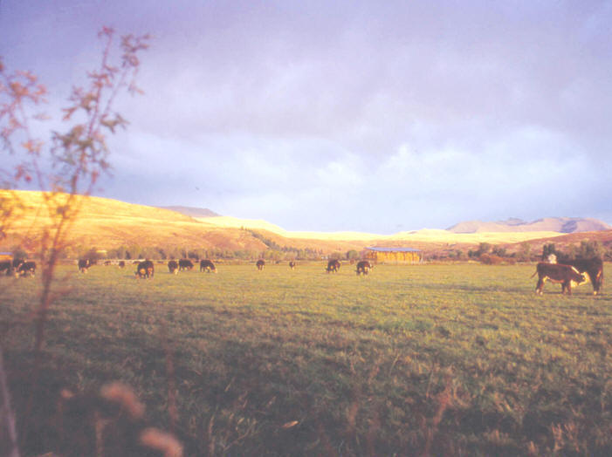
Country Natural Beef
Land stewardship standards (their Graze-well/Raise-well Principles) are certified by third party inspections from the Food Alliance.
The cattle are processed by an independently owned packer in Washington.
CNB operates sophisticated supply chain logistics.
  Over 47,000 head of cattle from over 100 ranch families were sold by CNB in 2006.
http://www.countrynaturalbeef.com/
Grazing Well: Principles of livestock management that lead to healthy land, livestock and people.

Slide 23
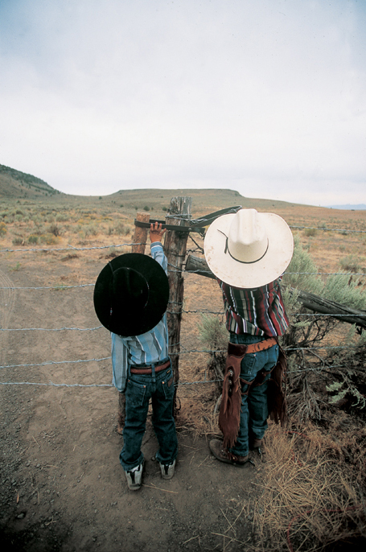
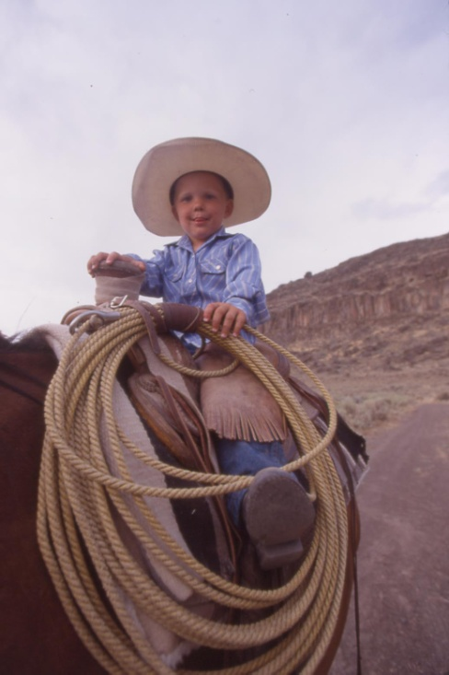
Country Natural Beef
Meat prices are based on the costs of sustainable production.
  2006 average cost of production was $1.04/lb live weight for an 800 lb yearling.
  A 3 percent profit margin is added on for a targeted return of
  $1.12/ lb.

Slide 24

Country Natural Beef
CNB’s strategic retail partners are mainly Whole Foods, New Seasons Market, Puget Consumer
Co-op stores, Burgerville restaurants and Bon Appétit (catering service to colleges and corporate cafeterias).
The identity of Country Natural Beef (or its ranch families) is preserved throughout the supply chain.

Slide 25
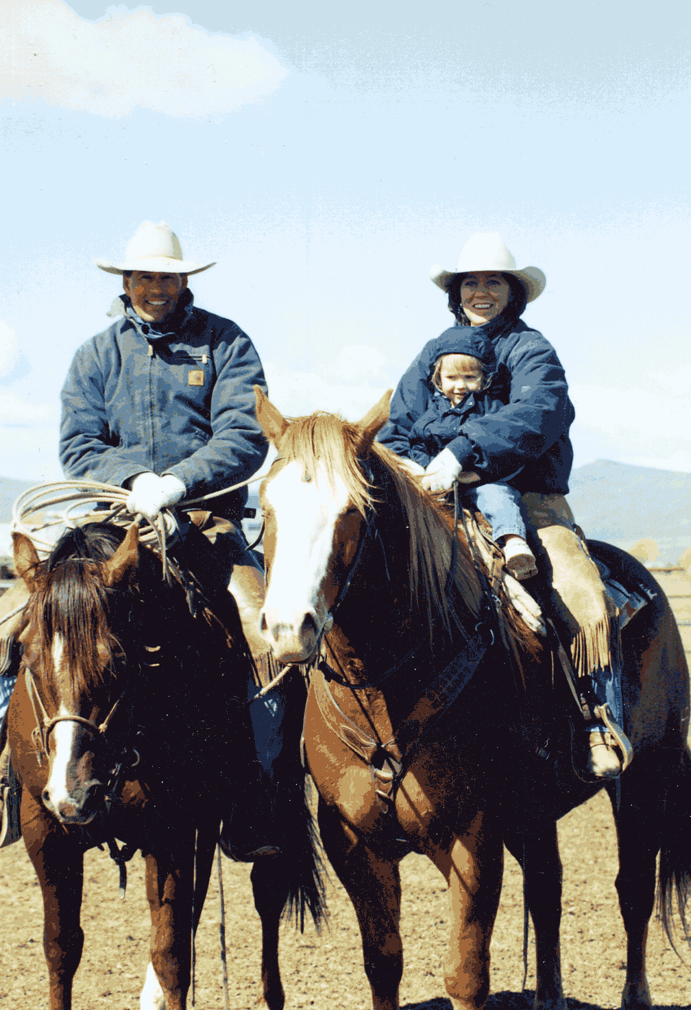
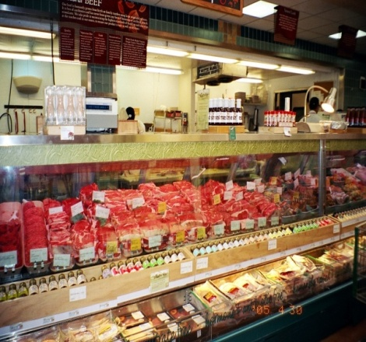
Country Natural Beef
To become a CNB cooperative member a ranch would need to:
Be sponsored by an existing CNB member
Go through a two-year trial membership
Pass Food Alliance certification
Place in the feedlot a minimum of 160 head of cattle annually (two 80-head lots)
Attend two semi-annual all-member meetings
Engage three days a year in customer
outreach where ranchers interact with meat cutters, chefs, store owners and consumers

Slide 26
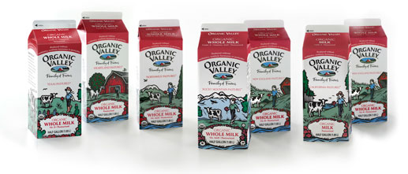

Example of a mid-tier value chain
Organic Valley
Cooperative of 1,332 farms had sales of $330 million in 2006 of mostly dairy products under the Organic Valley label.
Has eight different regions, and seeks a strict policy to only use milk from the region where it is produced and which is as close to the processing plant as possible.
http://www.organicvalley.coop/
George Siemon
C-E-I-E-I-O

Slide 27
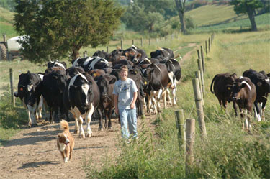
Who owns Organic Valley?
Family farmers!
How it Works
Farmer members establish equity when they join the co-op.
A national Board of Directors is elected from the membership..
Pay price is based on cost of production and is determined by farmer members who also receive support in production, organic certification, farm planning, feed sourcing, veterinary consultation and more.
http://www.farmers.coop/
"If we treat the soil right, it will return life to us. Caring for the earth, particularly the soil, is what God intended for us to do." Kore Yoder, Lewisburg, Pennsylvania, 13th generation farmer

Slide 28
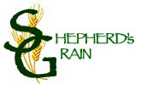


Example of a mid-tier value chain
Shepherd’s Grain http://www.shepherdsgrain.com/
A group of family farmers (mostly in Washington), certified as practicing sustainable agriculture by the Food Alliance, who sell high quality flours (high and low gluten and whole wheat) to specialty bakers, restaurants (Hot Lips Pizza) and catering (Bon Appétit).
http://www.hotlipspizza.com/index.html
http://www.bamco.com/

Slide 29
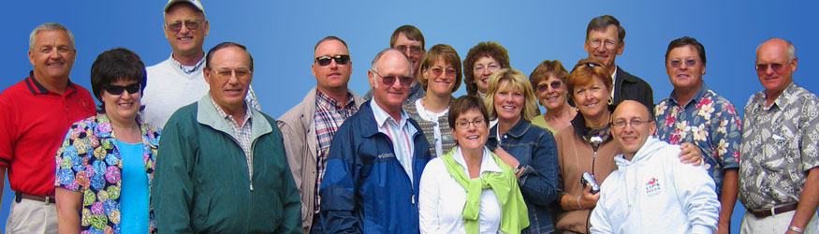
Farmers
These are our wheat farmers. They make up the Shepherd’s Grain Cooperative, a Food Alliance certified group of farms around Reardon, Washington. They have made an unprecedented commitment to practice a no-till method of cultivation, to grow a hard winter wheat, to retain the grain’s identity and to sell the product in the local market instead of shipping the entire crop overseas. This is all a new way of thinking.

Slide 30




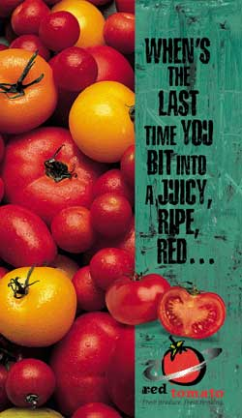
Example of a mid-tier value chain
Red Tomato
A non-profit brokerage based in Massachusetts that connects fresh fruit and vegetable growers (especially fruit) throughout New England with retailers (such as Whole Foods, Trader Joes), distributors and food service, providing logistics, distribution, marketing and education including packaging, labeling and point of purchase materials, under the Red Tomato brand.
http://www.redtomato.org/

Slide 31
Red Tomato’s mission is connecting farmers and consumers through marketing, trade and education, and through a passionate belief that a family-farm, locally based, ecological, fair trade food system is the way to a better tomato
Red Tomato believes, “…in fair prices for farmers, transparency in all our dealings, stewardship of the earth and the power of keeping the farmer’s story at the center of our branding and marketing.”
  Red Tomato co-director and founder, Michael Rozyne, was a co-founder of the fair trade coffee company, Equal Exchange.
Uses packaging to tell a story and create brand identity
  Eco Apple™ Program
  Born and Raised Here™ Program
Offers a variety of signage, banners and brochures to help promote their produce and the farmers who grow it.
http://www.redtomato.org/packaging.php
http://www.redtomato.org/merchandising.php

Slide 32
Concluding thoughts
The growth in demand for local foods and “food with a face” has created an opportunity for the development of mid-tier value chains.
Mid-tier value chains help mid-size farms market a higher volume of products for a differentiated-product price (vs. commodity prices).
Value chains require a new way of thinking about supply chain relationships, and farmers can learn from successful value chain pioneers.

Slide 33
References
Stevenson, Steve and Rich Pirog. Middle Marketing Food Value Chains: Definitions and Distinctions. www.agofthemiddle.org/papers/valuechain.pdf
Country Natural Beef. www.oregoncountrybeef.com/
Food Alliance. foodalliance.org/
Whole Grains Council. www.wholegrainscouncil.org/
Gray, Thomas. “Business structure helps producers address power disparity in the marketplace.” Rural Cooperatives. www.rurdev.usda.gov/rbs/pub/may07/may07.pdf
Food Alliance Certified Pumpkin in Burgerville Milkshakes and Smoothies - Fall 2009 www.youtube.com/watch?v=UfEJBTuGjC8
Stahlbush Island Farms. www.stahlbush.com/
Truitt Bros., Inc. www.truittbros.com/
Burgerville. burgerville.com/
Organic Valley. www.organicvalley.coop/

Slide 34
References
Stevenson, Steve. June, 2009. Values-based food supply chains: Country Natural Beef. www.agofthemiddle.org/pubs/cnbcasestudyfinalrev.pdf
PCC Natural Markets. www.pccnaturalmarkets.com/
Stevenson, Steve. June, 2009. Values-based food supply chains: Organic Valley. www.agofthemiddle.org/pubs/ovcasestudyfinalrev.pdf
CROPP Cooperative. www.farmers.coop/
Stevenson, Steve. June, 2009. Values-based food supply chains: Shepherd’s Grain. www.agofthemiddle.org/pubs/sgcasestudyfinalrev.pdf
Shepherd’s Grain. www.shepherdsgrain.com/
Hot Lips Pizza. www.hotlipspizza.com/index.html
Bon Appétit. www.bamco.com/
Stevenson, Steve. June, 2009. Values-based food supply chains: Red Tomato. www.agofthemiddle.org/pubs/rtcasestudyfinalrev.pdf
Red Tomato. www.redtomato.org/

